Slide 1
FROM RASTER TO RAYS IN GAMES
Morgan McGuire NVIDIA SIGGRAPH 2019
Notes:
This course is entitled “Are we there yet?” Of course we’re not, that’s why you’re here.
The important questions are:
When will we be done with ray tracing?
What problems do we need to solve to get there?
How should we approach those problems?
When…What...How
Let’s see what the past can teach us about the future to try and answer these.

Slide 2
PHOTOGRAPHY &
RECORDING PERMITTED

Slide 3
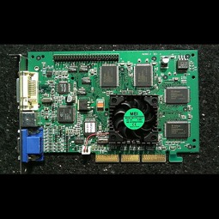
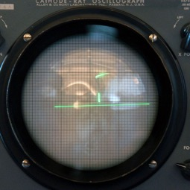
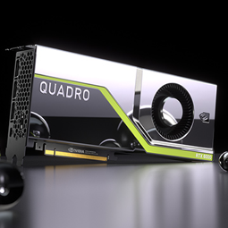
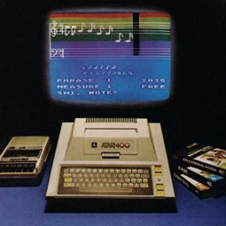
20 Year hardware revolutions
First GPU:
GeForce 256
First Video Game: Tennis For Two
First Ray Tracing GPU:
Turing
First Gaming PC:
Atari 800
1958
1979
1999
2018
Source: Computer History Museum http://www.computerhistory.org/
Notes:
I’ve simplified the timeline and captions here by omitting early good ideas that didn’t quite impact the market, but this is accurate in the essential points.
Here we go. GAMING became VIDEO gaming in 1958 with the research demo Tennis for Two.
Two decades later, we got home gaming with Atari.
Two decades after that, the first discrete PC GPU
And last year, two decades after the PC GPU, we got the first mainstream ray tracing GPU for gaming.
Every 20 years.
So we are now at the START of the real-time ray tracing revolution in games.
This is a big deal—for many game programmers, this kind of graphics revolution has never occurred during their professional lives.
So, let me make another observation, especially for those of you who have never seen this happen before.
When revolutionary tech appears, it first is in one place and has a tiny base. But it only takes about five years for everyone to catch up with these innovations, and then we accelerate from first mover to pervasive and taken for granted. Watch:

Slide 4
5 years to pervasive
First GPU:
GeForce 256
First Video Game: Tennis For Two
First Ray Tracing GPU:
Turing
First Gaming PC:
Atari 800
Pervasive
Gaming
(Spacewar! 4.8)
Pervasive
Home Gaming
(NES)
Pervasive
GPU
(Doom 3)
Pervasive
Ray Tracing
1958
1963
1979
1985
1999
2004
2018
2023
Source: Computer History Museum http://www.computerhistory.org/
Notes:
1958: first game
Five years later, the final version of Spacewar! is running on every computer.
1979: First gaming PC
About five years later, we have The Legend of Zelda and Super Mario Bros because the NES is available worldwide.
1999: First GPU
About five years later, we have the games that require not only a GPU, but a programmable GPU
So, I predict that by 2023 ray tracing technology will be pervasive across every GPU, on every gaming platform. We’re going to see games that REQUIRE ray tracing GPUs rather than just take advantage of them.
But it isn’t going to happen on its own. We have to create this future. You and me, AMD, Intel, NVIDIA, Microsoft, Activision, EA, Ubisoft, all of us.
To make a strategy for how to do that, let’s again learn from the past.

Slide 5
A GAME GRAPHICS ROADMAP
Notes:
Instead of game hardware, let us look at software this time.

Slide 6
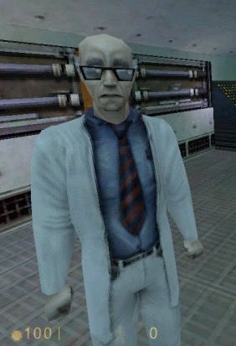
A GAME GRAPHICS ROADMAP
1978-1999
Antiquity
Half-Life
Valve 1998
Notes:
Look, anyone who made games before programmable shading is a legend. That’s when we worked out all of the gameplay ideas and in retrospect it is amazing what was accomplished on those software and fixed-function renderers.
But as far as technology goes they’re basically the ancient world and have no bearing on today’s graphics.

Slide 7
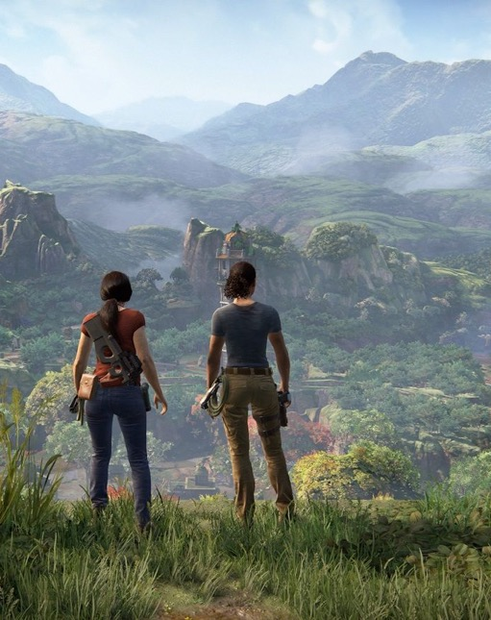
A GAME GRAPHICS ROADMAP
1978-1999
2000-2018
Antiquity
Raster Heroes
Runtime GPU Rasterization
Primary rays
Deferred/fwd shaders
Shadow maps
SS AO, RT, DOF, MB
OIT tricks
Offline CPU Ray Tracing
Baked probes
Baked light maps
Baked visibility
Uncharted: The Lost Legacy
Naughty Dog 2017
Notes:
Now, the world we’ve been in for the past two decades.
GPUs gave us all of the amazing power of programmability…but at a price. We pushed the complexity of rasterization so far that we ended up with this huge split between offline and runtime, and with all kinds of unmanageable workflow. There are very few people in the world who can write a cross-platform, truly peak-performance renderer. And that actually got harder with DX12 and Vulkan. They are the raster heroes who make today’s amazing games possible despite the crushing complexity.
We had to approximate so many things in this era that despite physically correct materials, there’s no hope of physically correct lighting, and artists are constantly manually lighting, baking, and hand-tuning everything.
So we’ve followed an arc that lead to unbelievably gorgeous games but has nearly tapped out what we can do with raster alone.
And just when we thought we couldn’t pack anything else into a game pipeline…

Slide 8
A GAME GRAPHICS ROADMAP
1978-1999
2000-2018
2019-2023
Antiquity
Raster Heroes
Ray/Raster Coexist
Raster
Primary rays
Deferred/fwd shaders
Shadow maps
SS AO, RT, DOF, MB
OIT tricks
Rays
Mirror reflection
Dynamic probes & light maps
Hard shadows
Refraction transparency
Adaptive sampling
Control
Remedy 2019
Notes:
We got ray tracing GPUs. This is where we are now.
Full raster pipeline with all of the modern tricks
Extra art resources to hide engine limitations
Plus ray tracing for one effect, laboriously optimized
Battlefield V: smooth surface reflections
Metro 2033: one-bounce diffuse GI
Shadow of the Tomb Raider: direct illumination shadows
The first game to use RT extensively will be Control. It does all three of reflections, shadows, GI. But it also has to have fallbacks for non-ray tracing solutions. It is like the cost of developing one and a half games.
But the games where raster and rays coexist definitely look better than raster only. And there are even some workflow advantages:
Art workflow speedups
Interactive lighting tools and accelerated baking (e.g., Frostbite)
Minimize manual intervention; lightmap UV (e.g., DDGI…more on Tuesday)
Reduce engine complexity by switching some effects to ray tracing or off, no fallback
Omni light shadows
Dynamic GI
Adaptive supersampling (ATAA)

Slide 9
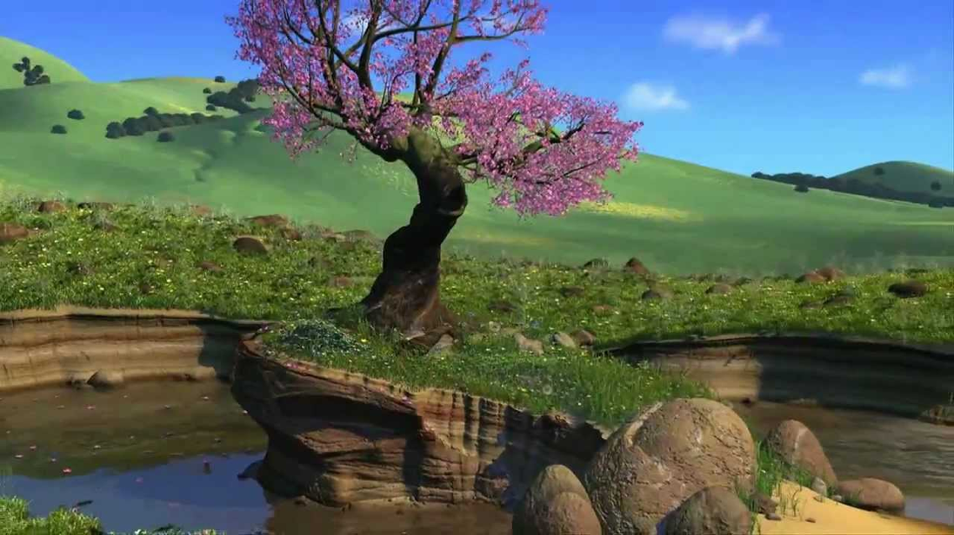
A GAME GRAPHICS ROADMAP
1978-1999
2000-2018
2019-2023
Antiquity
Raster Heroes
Ray/Raster Coexist
Control
Remedy 2019
A Bug’s Life
Walt Disney Pictures & Pixar Animation Studios 1998
Notes:
A Bug’s Life was done in Renderman using micropolygon rasterization and manually-placed bounce lights. There was no physically-based lighting or even energy conservation. It had shadow maps and AO and all kinds of tricks that you know about.
And they added a few rays per sample on top of that to make the water reflections and refraction.
Don’t get me wrong, this looks amazing. It is what video games are going to look like in 2018 and 2019. But the effort to produce these visuals was phenomenal. It was the breaking point. It has all of the workflow problems of your current raster pipeline, with added complexity on top. That’s not a sustainable content creation model.
And that’s why ten years after it hit this point, the entire film industry moved to exclusively path tracing.

Slide 10
A GAME GRAPHICS ROADMAP
1978-1999
2000-2018
2019-2023
Circa 2035
Antiquity
Raster Heroes
Ray/Raster Coexist
Path Tracing
Coco
Walt Disney Pictures & Pixar Animation Studios 2018
Notes:
Film just 100% embraced path tracing to clean up their workflow with predictability, consistency, photorealistic transport, and spending compute cycles instead of artist time.
Film had the luxury of being able to scale the available compute resources and some flexibility on render time. Games have a hard real-time constraint and have to meet the hardware where it is, in the consumer space.
I think we are going to end up doing full real-time path tracing, but not for a long time. And “path tracing” won’t look like the algorithm we now know when we get there.
What is more interesting is what will happen in about five years, when we can count on ray tracing being present everywhere but still need raster to accelerate it…

Slide 11
Recommended Reading
Case studies of offline rendering’s transition to path tracing
Christensen & Jarosz, The Path to Path-Traced Movies, CG&V 2014
Keller et al., The Iray Light Transport Simulation and Rendering System, arXiv, 2017
ACM Transactions on Graphics volume 37 issue 3, 2018:
Georgiev et al. (SolidAngle/Autodesk), Arnold: A Brute-Force Production Path Tracer
Christensen et al. (Pixar), RenderMan: An Advanced Path Tracing Architecture for Movie Rendering
Kulla et al. (Sony Pictures Imageworks), Sony Pictures Imageworks Arnold
Burley et al. (Walt Disney Feature Animation), The Design and Evolution of Disney’s Hyperion Renderer
Fascione et al. (Weta), Manuka: A Batch Shading Architecture for Spectral Path Tracing in Movie Production
Notes:
And here’s a set of seven papers that give detailed systems descriptions of how offline rendering moved to path tracing and solved many of the problems they encountered.
Problems that I think we need solutions to for real-time ray tracing in the next five years.
Back to our story…

Slide 12
A GAME GRAPHICS ROADMAP
1978-1999
2000-2018
2019-2023
2024-2034
Circa 2035
Antiquity
Raster Heroes
Ray/Raster Coexist
Ray/Raster Hybrid
Path Tracing
Area light shadows
Ambient occlusion
Glossy reflection
Rays for data structures
Ray traced audio
Perfect particle collisions
Perfect AI visibility
Adaptive supersampling
Diffuse interreflection
Complex transparency
Foveated rendering
Beam racing
Stochastic motion blur
Full path tracing
Notes:
Games that REQUIRE ray tracing and can jettison many raster hacks.
Massively reduced engine maintenance and art costs, predictable, robust effects
Rays first for new looks:
Unlimited lights, true area lights, all emissives as real lights
Lots of dynamic lighting
Not afraid of glass, water, and shiny metal
Raster accelerator:
Primary visibility and spot-light shadows
SSRT and SSAO accelerators failing over to ray tracing
That was my analysis of “WHEN” we can expect advances. Let’s dig into the specific problems.

Slide 13
Game ray tracing problems
Materials
Geometry
Lights
Sampling
See also:
Filmic quality at 30 fps, Tatarchuk et al. GDC’19
Open Problems in Real-Time Rendering, SIGGRAPH’19 (Thursday)
Notes:
Well, the four things that we deal with in rendering are materials, geometry, lights, and sampling…and each one of those presents a unique challenge for real-time ray tracing.

Slide 14
materials

Slide 15
Procedural materials
Fast hit/material shaders require:
Small compute, to fit in the instruction cache and avoid stalls
Small data, to maximize warp occupancy
Coherent instructions, to maximize thread occupancy
Coherent data, to maximize coalescing and data cache hits
Notes:
That’s what programmers know. Small, simple, coherent is fast. So, what do artists do?

Slide 16
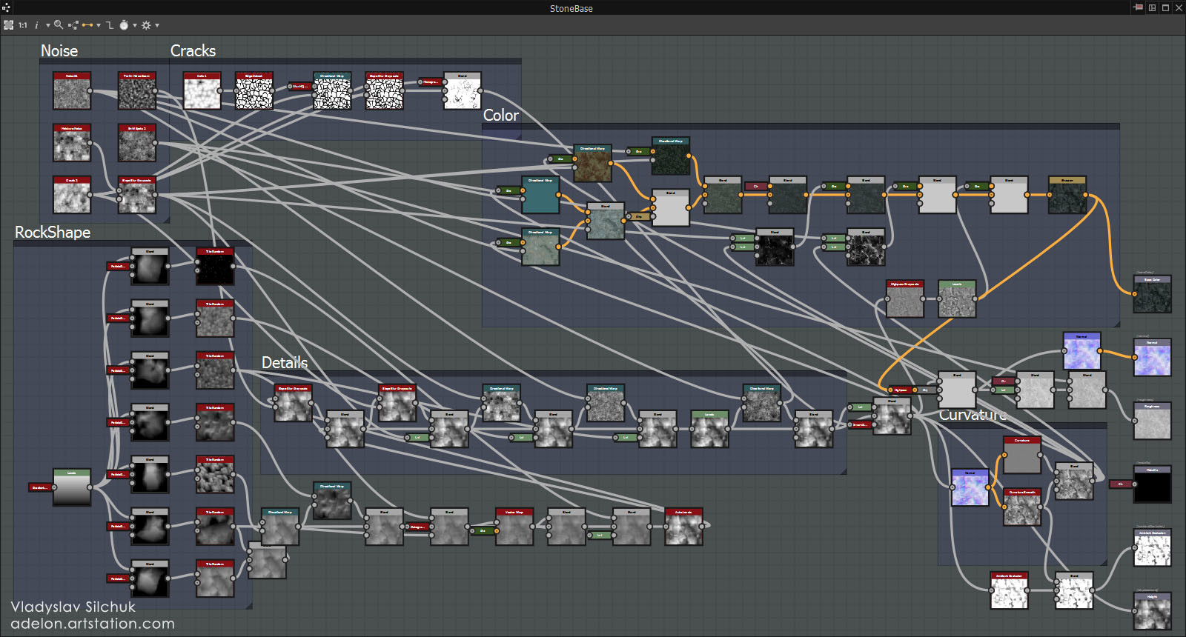
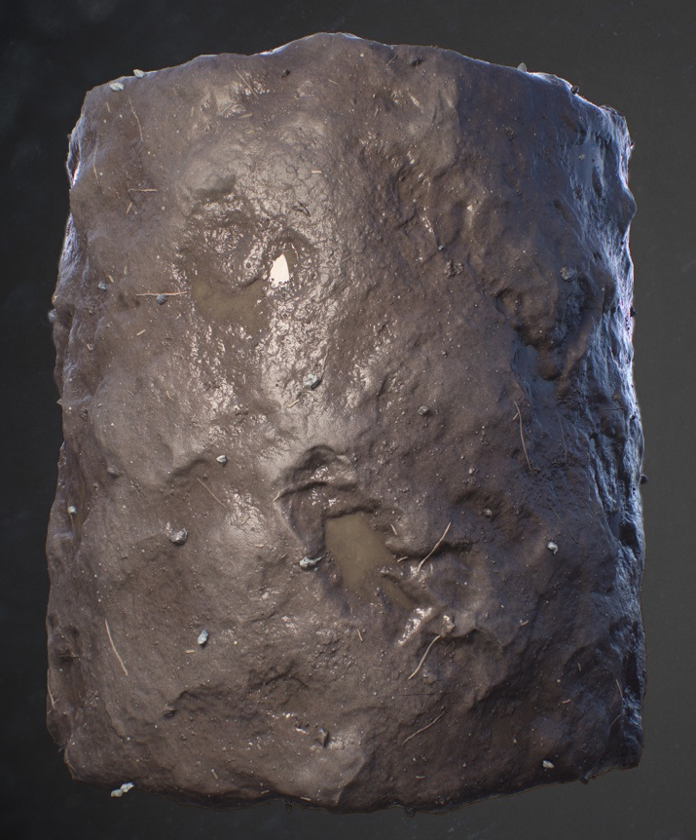
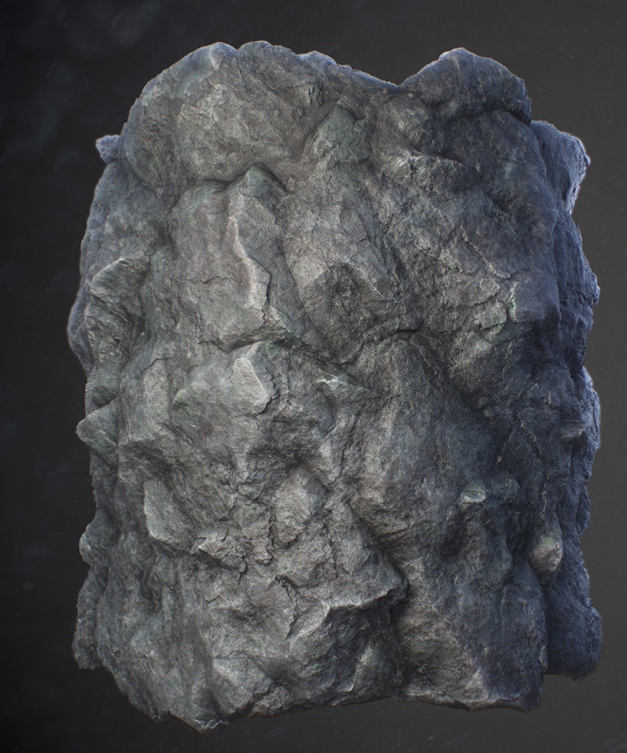
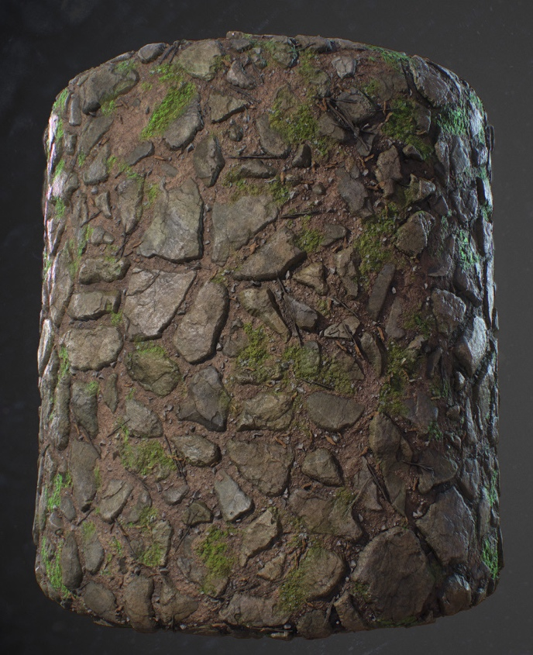
Procedural materials
Notes:
It definitely isn’t’ small. And it is full of data dependence. But even worse, that’s just one material. While one ray hit is evaluating this, some other ray is hitting another material…and another material…and they’re all incoherent

Slide 17
Procedural materials
Today’s solution of sorting / compaction / binning is good, but not good enough.
Future: start with brute force baking of all materials (Manuka)
move to dynamic megatexture baking, like a page table
challenge: massively parallel scheduling
Manuka: A Batch Shading Architecture for Spectral Path Tracing in Movie Production, Fascione, Hanika, Leone, Droske, Schwarzhaupt, Davidovic, Weidlich, and Meng, ToG’18

Slide 18
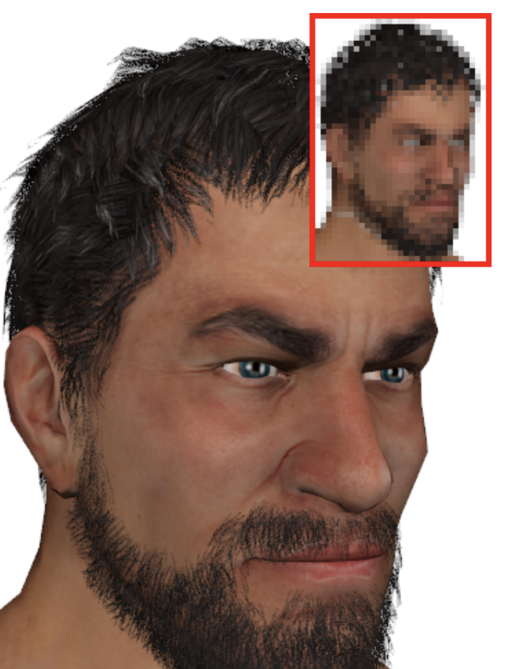
Binary Coverage testing
“Alpha” test is inefficient on both CPU and GPU
Interacts with motion blur, decals, fog, depth of field, and shadowing
Hashed alpha testing, Wyman & McGuire I3D’17
Notes:
“Alpha” test is inefficient on both CPU and GPU: leaves tight traversal kernel or accelerated traversal core
Need fixed-function support, but:
API/HW must agree with engine on material model
Cannot afford unconstrained graphs
Complicated by level-of-detail, which yields fractional alpha:
Stochastic coverage is an active research area, e.g., Hashed alpha testing, Wyman & McGuire I3D’17
Interacts with motion blur, decals, fog, depth of field, and shadowing

Slide 19
geometry

Slide 20
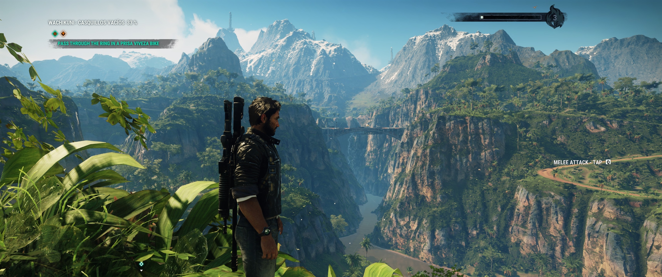
BVH Streaming
Just Cause 4, Avalance Studios 2018
Notes:
Games have big worlds today. We take for granted that we can stream endless materials and geometry in as the camera moves.
First generation ray tracing in games is struggling with this.
But this is mainly driver & API issue…will “just happen” as software and hardware vendors get more experience working together on ray tracing for games.
Somebody has to make it “just happen”, but I don’t think it is an open research problem.

Slide 21
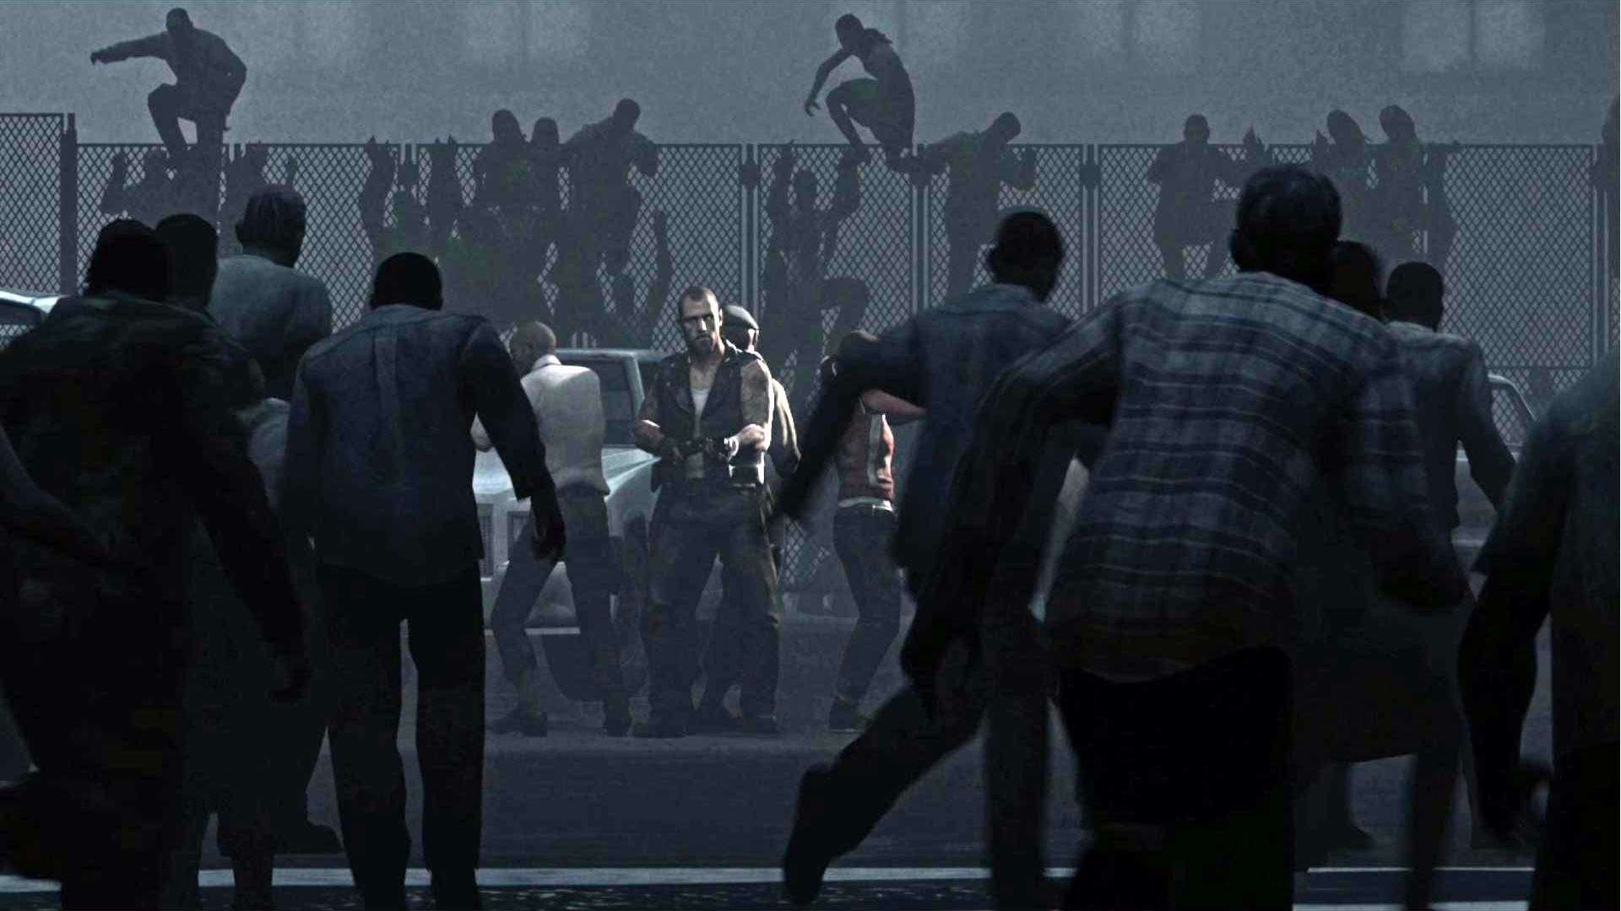
Animated instances
Left 4 Dead 2, Valve 2009
Notes:
This is a tough one. Many games today have hundreds of animated characters and trees visible at any time, because animating instances is really efficient in the rasterization pipeline.
But animated instances are a hard problem in ray tracing. Film never solved this in a massively parallel way—they basically have giant caches for globally locking and expanding instances when rays approach them. That doesn’t work on a GPU.
Game ray tracing today has to proactively expand and animate all instances, even if no rays go near them, and can’t handle level of detail for them. That’s a “Baking” approach. But this kind of geometry expansion won’t scale to 300 zombies or ten thousand trees. So, this is a big problem.

Slide 22
Sampling & shading

Slide 23
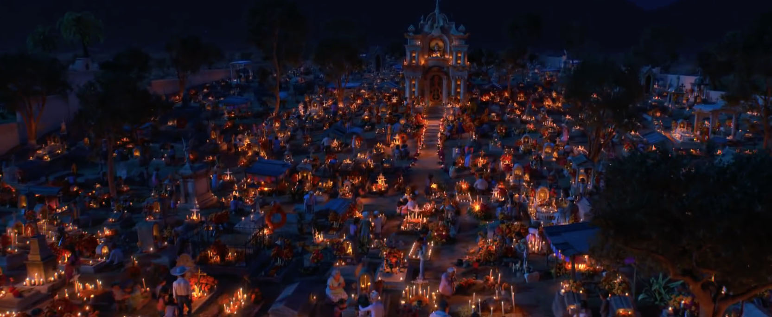
Light sampling
18,000 light sources in Coco ©2017 Disney•Pixar. All Rights Reserved.
Notes:
Sampling a few small lights is not hard.
But when you have a scene like this and the artists want it to “just work” without hacking which are real lights and which are fake…
Sampling environment maps, emissives, scenes with tens of thousands of lights…

Slide 24
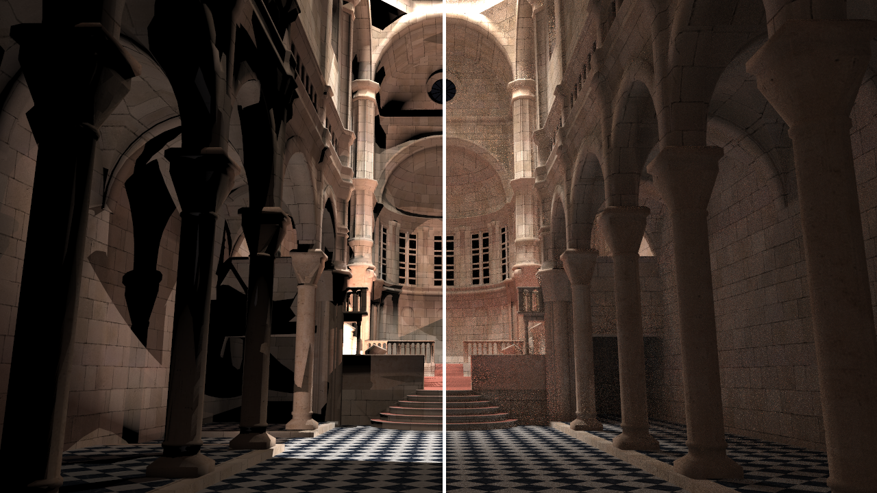
Light sampling
Stochastic Lightcuts, Yuksel HPG’19
Dynamic Many-Light Sampling for Real-Time Ray Tracing, Moreau, Pharr, and Clarberg, HPG’19
Open Problems in Real-Time Rendering, Wyman and Bitterli, SIGGRAPH’19 (Thursday)
Notes:
We’re going to have to solve this stochastically, so it comes down to the question of which few lights to sample at each pixel.

Slide 25
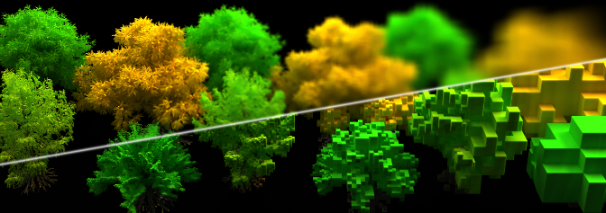
Band limiting
aka geometric and material level of detail, aka prefiltering
The SGGX Microflake Distribution, Heitz, Dupuy, Crassin, and Dachsbacher, SIGGRAPH’15
Filtering non-linear transfer functions on surfaces, Heitz, Nowrouzezahrai, Poulin, and Neyret, TVCG’14
Interactive indirect illumination using voxel cone tracing, Crassin, Neyret, Sainz, Green, and Eisemann, PG’11
https://research.nvidia.com/publication/2015-08_The-SGGX-microflake

Slide 26
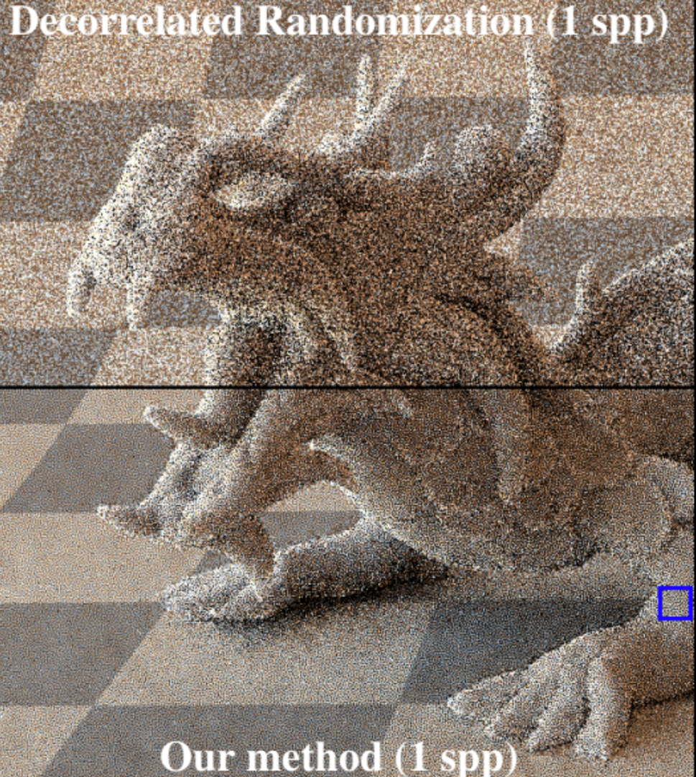
Perceptual low discrepancy
A Low-Discrepancy Sampler that Distributes Monte Carlo Errors as a Blue Noise in Screen Space, Heitz, Belcour, Ostromoukhov, Coeurjolly, Iehl, SIGGRAPH Talk '19
Distributing Monte Carlo Errors as a Blue Noise in Screen Space by Permuting Pixel Seeds Between Frames, Heitz and Belcour, EGSR'19
Heitz and Belcour 2019

Slide 27
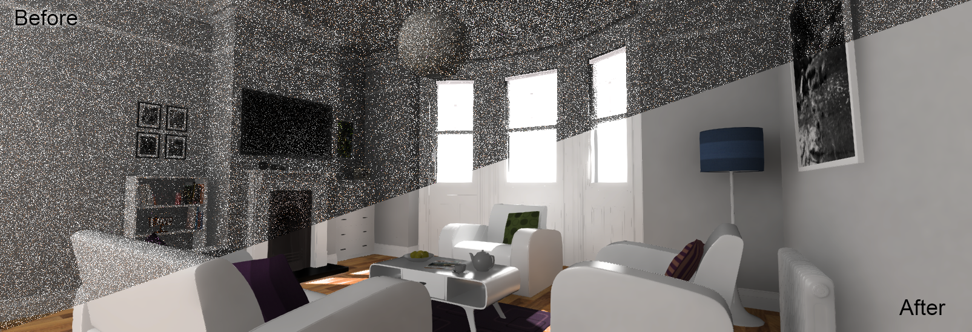
Fast Denoising
Spatiotemporal Variance-Guided Filtering: Real-Time Reconstruction for Path-Traced Global Illumination, Schied, Kaplanyan, Wyman, Patney, Chaitanya, Burgess, Liu, Dachsbacher, Lefohn, Salvi, HPG’17
An Efficient Denoising Algorithm for Global Illumination, Mara, McGuire, Bitterli, Jarosz, HPG'17
Interactive Reconstruction of Monte Carlo Image Sequences using a Recurrent Denoising Autoencoder, Chaitanya, Kaplanyan, Schied, Salvi, Lefohn, Nowrouzezahrai, Aila, SIGGRAPH'17
Notes:
Advantages:
Essential last-step boost—even film uses it
Diminishing returns: O(n²) Monte Carlo convergence favors reconstruction
Challenges:
Time spent denoising is time hiding errors instead of getting better data
Film denoising barely works and assumes 100’s of rays per pixel
Bandwidth-limited; hard to accelerate
Low spp real-time denoisers only for large, static, in-focus, opaque, rough surfaces (volumes, transparents, complex reflections, small features, motion blur, depth of field)
This noise issue leads us to an inherent tension in rendering, which I’ll address two ways.

Slide 28
Inherent tension

Slide 29
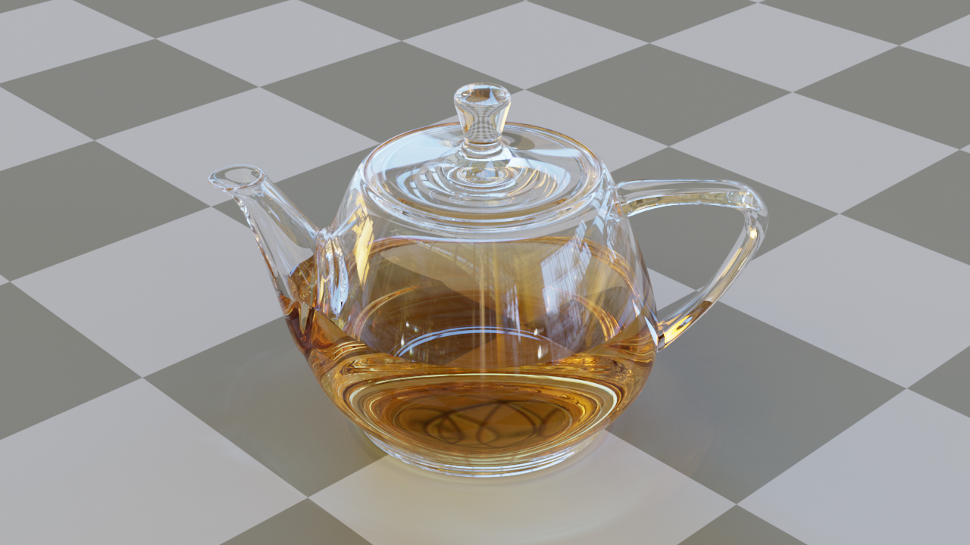
Sparse, deep paths
https://benedikt-bitterli.me/resources/images/teapot-full.png
Notes:
To render this scene, or any glass holding liquid, the renderer needs to be able to handle paths that are at least 7 nodes deep:
air-glass-liquid to get in, glass-air-background to get out, and then to some light source. If you expect to see global illumination through glass, then you’d better have something like 10-deep paths.
This is actually an easy case…

Slide 30
Sparse, deep paths
https://benedikt-bitterli.me/resources/images/curly-hair.png
Model by Cem Yuksel
https://benedikt-bitterli.me/resources/images/glass-of-water.png
Model by aXel
Notes:
Here you might need paths of depth 30 or more. This is a problem because you can easily imagine scenes where some paths have length three and some have length 30.
This is the same problem as the reflective case that Alex showed this morning where a many pixels are shallow but the headlights of a car go hundreds of events deep

Slide 31
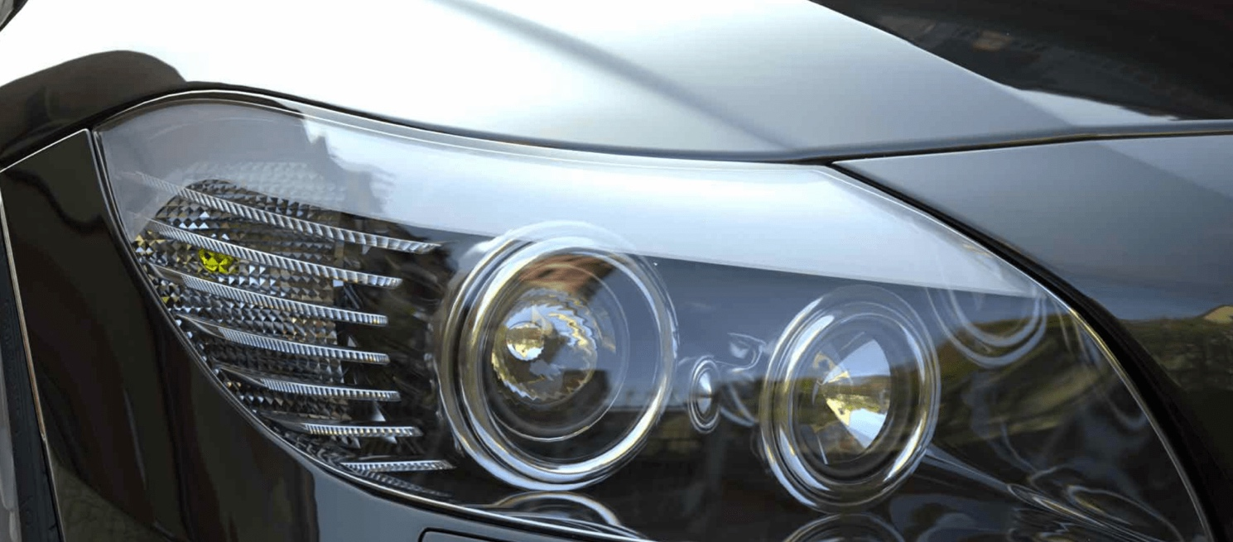
Sparse, deep paths
Alex Keller, Iray
https://benedikt-bitterli.me/resources/images/curly-hair.png
Model by Cem Yuksel
https://benedikt-bitterli.me/resources/images/glass-of-water.png
Model by aXel
Notes:
Iray cares about that case because it is used for predictive rendering in the design industry…but hair, glass, and water are situations that happen more frequently in games and where players will really notice if we try to simplify the geometry.
The only way to tackle this is some kind of load balancing and work stealing. So it is an operating-system style scheduling problem, but across hundreds of millions of rays…
This scheduling issue is really a core problem that keeps arising.
- Material incoherence
- Traversal incoherence
…and the big one, which I’ve saved for last:

Slide 32
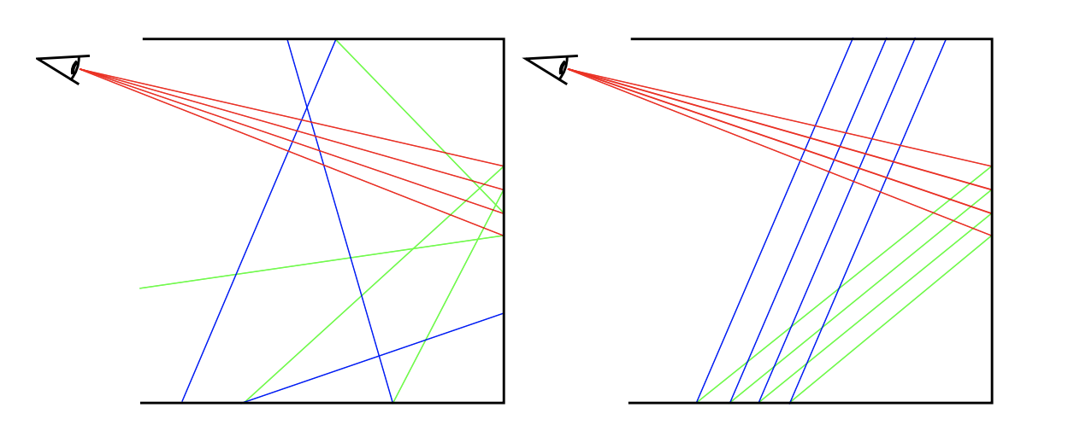
Incoherent samples, Coherent threads
Coherent path tracing, Sadeghi, Chen, Jensen, jgt’09
Stream compaction for deferred shading, Hoberock, Lu, Jia, Hart, HPG’09
Decoupled sampling for graphics pipelines, Ragan-Kelley, Lehtinen, Chen, Doggett, Durand
ACM Transactions on Graphics, TOG’11
Image space gathering, Robison & Shirley HPG’09
Notes:
Monte Carlo converges fastest when the paths look like the diagram on the left.
Parallel processors run fastest when the paths look like the diagram on the right.
This is a really tricky case where theory hits systems, or math hits engineering.
The most important problem in REAL-TIME rendering is reconciling this disconnect (and the problem is pretty relevant to offline rendering as well, since time and electricity aren’t free.)
The papers I’ve listed have some really promising ideas in this space. I think they need to be revisited in the context of real-time ray tracing.
I started this talk by framing the entire course as three questions. Everything up until now was supporting arguments so that in my last two slides I can give my answers to those questions.

Slide 33
1. When will ray tracing be solved?
Notes:
When will we be done?
Few problems are truly ever “solved”, but things get good enough. Floating point is solved. Watertight rasterization is solved. Word processing is solved.
I believe it is technologically possible to solve ray tracing to the level of new AAA games requiring a ray tracing GPU by 2023.
And that by 2035 many games could be directly path traced.
When will we be done with ray tracing?
What problems do we need to solve to get there?
What are the most promising approaches?

Slide 34
1. When will ray tracing be solved?
First GPU:
GeForce 256
First Video Game: Tennis For Two
First Ray Tracing GPU:
Turing
First Gaming PC:
Atari 800
Pervasive
Gaming
(Spacewar! 4.8)
Pervasive
Home Gaming
(NES)
Pervasive
GPU
(Doom 3)
Pervasive
Ray Tracing
Pervasive
Path Tracing
1958
1963
1979
1985
1999
2004
2018
2023
2035
Source: Computer History Museum http://www.computerhistory.org/
Notes:
When will we be done?
Few problems are truly ever “solved”, but things get good enough. Floating point is solved. Watertight rasterization is solved. Word processing is solved.
I believe it is technologically possible to solve ray tracing to the level of new AAA games requiring a ray tracing GPU by 2023.
And that by 2035 many games could be directly path traced.
My argument here is historical from looking at graphics revolutions in both game and film rendering, and supported by an estimate of how difficult the relevant problems are. So, question 2: what are the problems?

Slide 35
2. What are the problems?

Slide 36
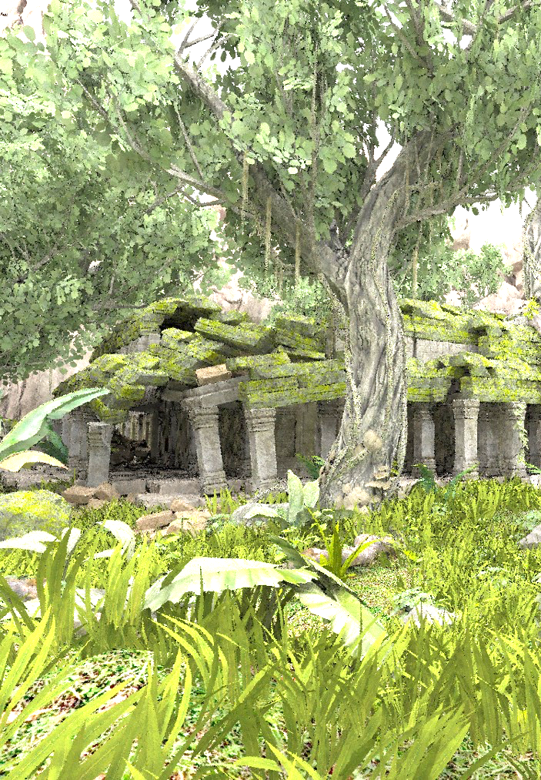
2. What are the problems?
Scheduling
Instruction cache, occupancy, SIMD coherence, data cache coherence, just-in-time streaming from disk
Decoupling
Reuse of intermediate expensive results across paths and frames.
Holistic Rendering
Cooperative perceptual QMC/MIS + many light sampling + prefiltering + denoising
Notes:
We’ve largely been attacking each of the pieces of rendering independently. I think everyone is coming to the conclusion that the big wins will be from considering sampling and reconstruction as a unified problem, and we’re starting to see results there.
I’d cluster these as:

Slide 37
2. What are the problems?
Scheduling
Instruction cache, occupancy, SIMD coherence, data cache coherence, just-in-time streaming from disk
Decoupling
Reuse of intermediate expensive results across paths and frames.
Holistic Rendering
Cooperative perceptual QMC/MIS + many light sampling + prefiltering + denoising
Notes:
And what are the most promising approaches?
Well, I think we need to tackle scheduling, decoupling, and holistic rendering head on.

Slide 38
3. How should we proceed?
Tackle scheduling, decoupling, and holistic rendering. Don’t hack the symptoms; attack the core
Notes:
I’ve already presented the details of each of the subproblems and those four papers that I think are ready to be revisited. I’d summarize that as look at the approaches in recent work by these folks…
And listening to the core problems (not necessarily the short-term solutions) that game developers are already describing for a crash course in the systems constraints.

Slide 39
3. How should we proceed?
Tackle scheduling, decoupling, and holistic rendering. Don’t hack the symptoms; attack the core
See recent work by Heitz, Belcour, Crassin, Yuksel, Jarosz, Bitterli, and ToG special issue
Attend production ray tracing sessions by game developers at SIGGRAPH, GTC, and GDC
Reality versus illusion demo, Unity 2019
https://www.youtube.com/watch?v=AG7DDXwYpD0
Notes:
Well, I think we need to tackle scheduling, decoupling, and holistic rendering head on.
I’ve already presented the details of each of the subproblems and those four papers that I think are ready to be revisited. I’d summarize that as look at the approaches in recent work by these folks…
And although the short-term solutions from any title are not likely to stand the test of time right now, you should be listening to the core workflow problems and systems constraints from game developers at production sessions.
Thank you

Slide 40
You are here
1978-1999
2000-2018
2019-2023
2024-2034
Circa 2035
Antiquity
Raster Heroes
Ray/Raster Coexist
Ray/Raster Hybrid
Path Tracing
Battlefield V
DICE 2018
Control
Remedy 2019
Metro Exodus
4A Games 2019
Shadow of the Tomb Raider
Eidos 2018
Justice
Weibo 2017/19
https://sites.google.com/view/arewedonewithraytracing

Slide 41
Acknowledgements
Thanks to my colleagues in offline rendering for their input for this talk:
Christophe Hery, Max Liani, & Per Christensen, Pixar
Larry Gritz, Sony Pictures Imageworks
Chris Perry, Bitfilms
Luca Fascione, Weta
Eric Enderton & Alex Keller, NVIDIA
and to my NVIDIA colleagues and other collaborators:
Aaron Lefohn, David Luebke, Peter Shirley, Matt Pharr, Ignacio Llamas, Edward Liu, Adam Marrs, Louis Bavoil, Jacopo Pantaleoni, Marc Blackstein, Steve Parker, John Burgess, Nikolaus Binder, Derek Nowrouzezahrai (McGill), Chris Wyman, Eric Heitz (Unity), Natalya Tatarchuk (Unity), and Stephen Hill (Lucasfilm)
https://sites.google.com/view/arewedonewithraytracing

Slide 43
3. How should we proceed?
1. When will ray tracing be solved?
2023: Ray tracing required for some games
2035: Path tracing is the real-time rendering standard
2. What are the Problems?
Scheduling
Decoupling
Holistic rendering
Recent work by Eric Heitz, Laurent Belcour, Cyril Crassin, Cem Yuksel, Wojciech Jarosz, Bennedict Bitterli
Production ray tracing sessions by game developers at SIGGRAPH, GTC, and GDC

Slide 44
Coexistence: rays + peak raster
Today
Art workflow speedups
Interactive lighting tools and accelerated baking (e.g., Frostbite)
Minimize manual intervention; lightmap UV (e.g., DDGI…more on Tuesday)
Reduce engine complexity by switching some effects to ray tracing or off, no fallback
Omni light shadows
Dynamic GI
Adaptive supersampling (ATAA)

Slide 45
HYBRID: rays + raster accelerator
2023
Ray tracing-required games
Massively reduced engine maintenance and art costs, predictable, robust effects
Rays first for new looks:
Unlimited lights, true area lights, all emissives as real lights
Lots of dynamic lighting
Not afraid of glass, water, and shiny metal
Raster accelerator:
Primary visibility and spot-light shadows
SSRT and SSAO accelerators failing over to ray tracing

